Slide 1
Lab 1a Solution
https://etc.jerl.im/2030lab1b.pptx

Slide 2
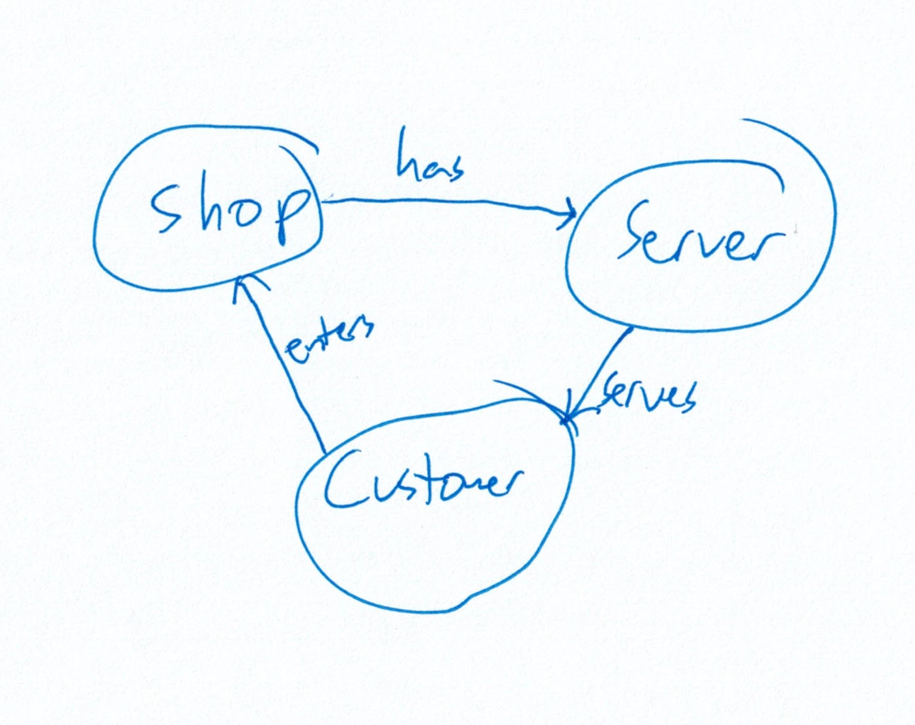
Map out “real world” scenario

Slide 3
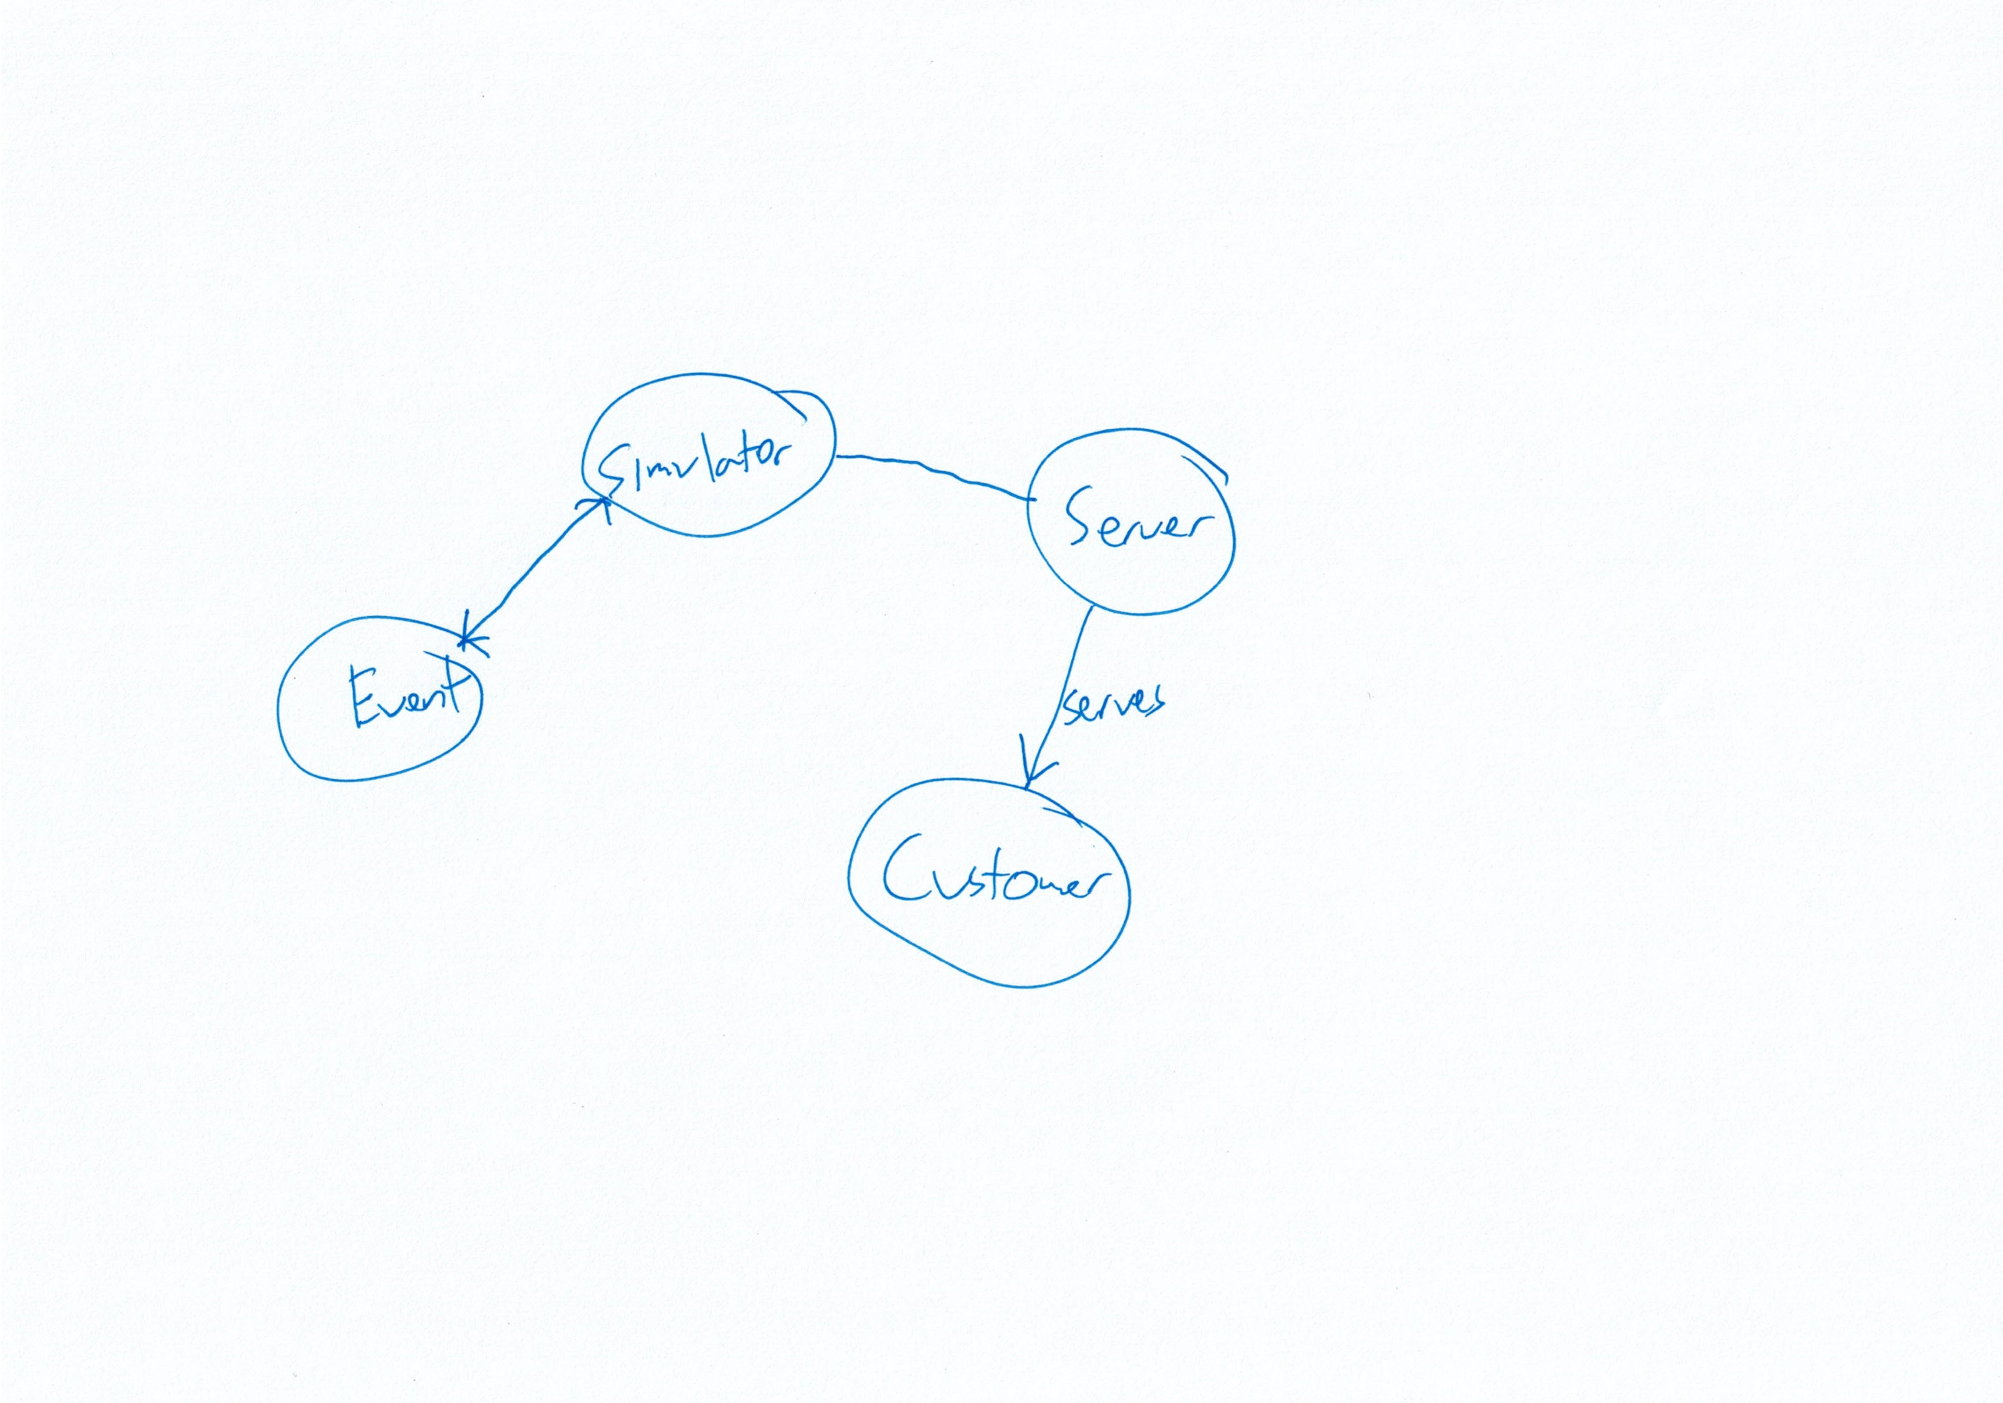
Start converting to classes

Slide 4
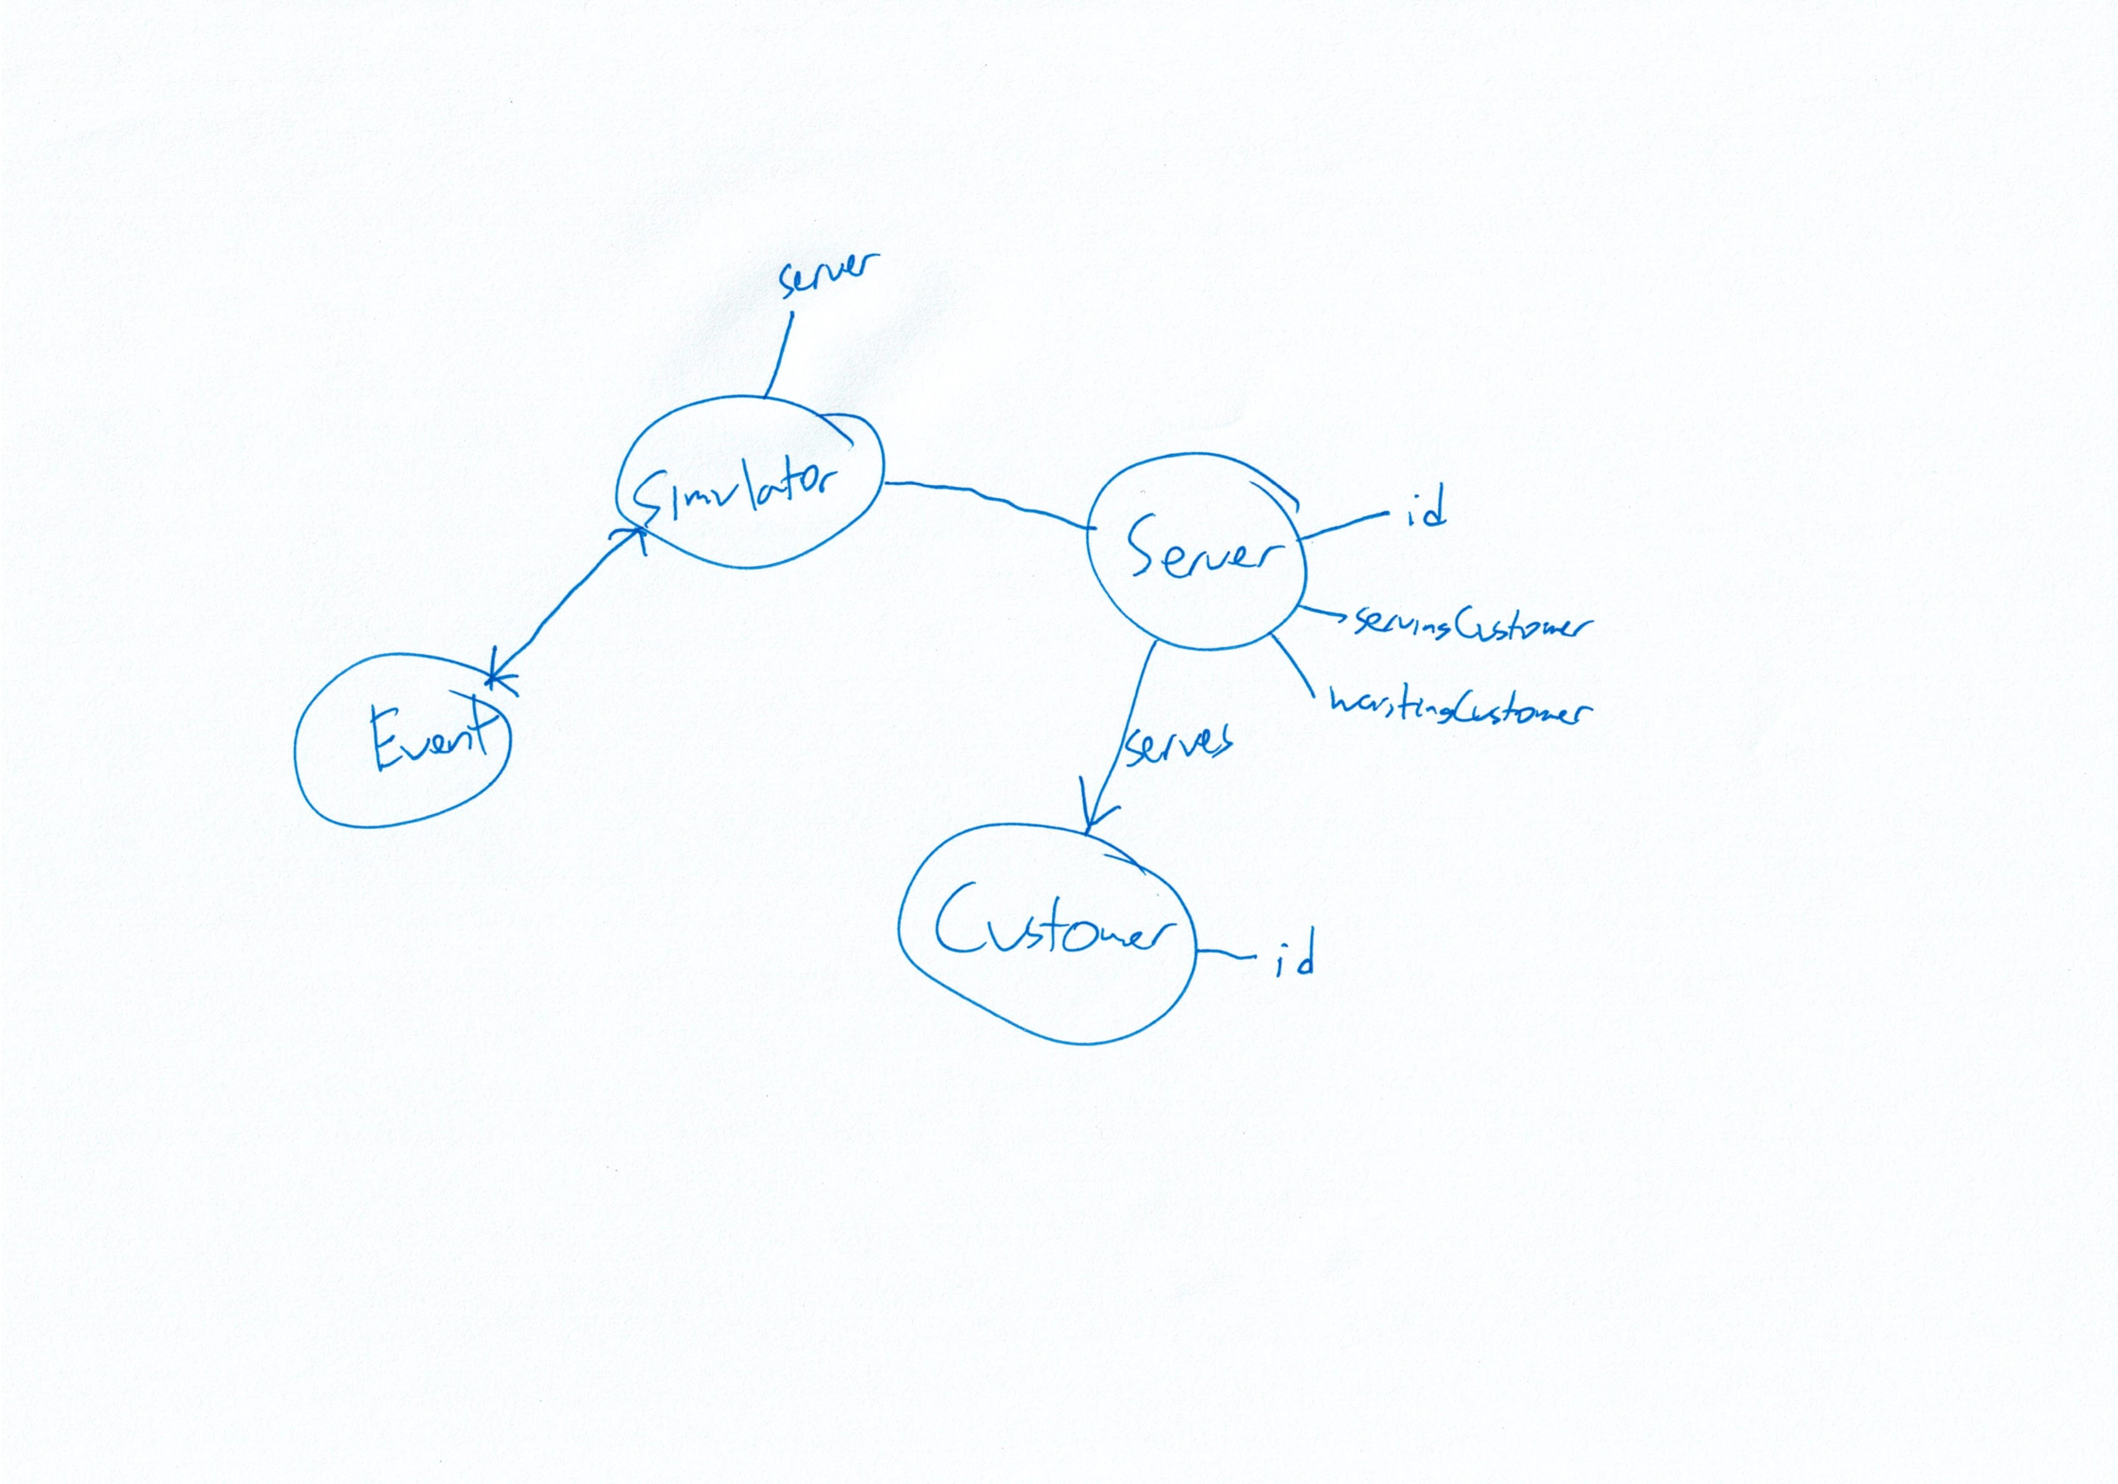
Add variables

Slide 5
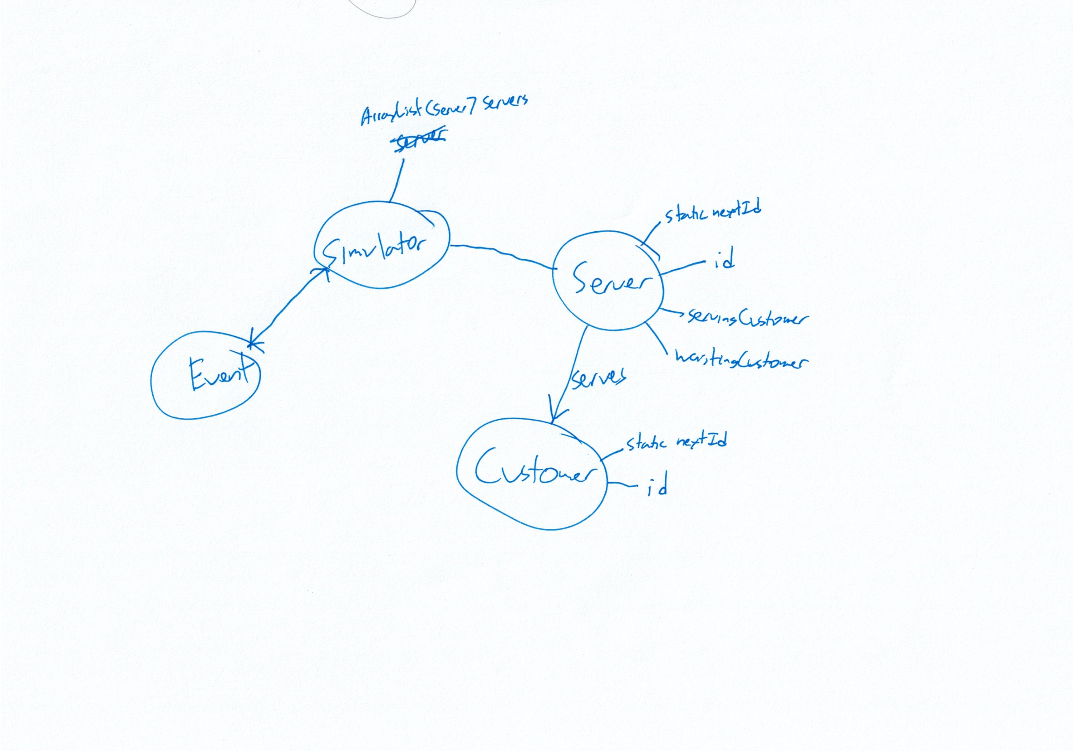
Multiple servers / static ID

Slide 6
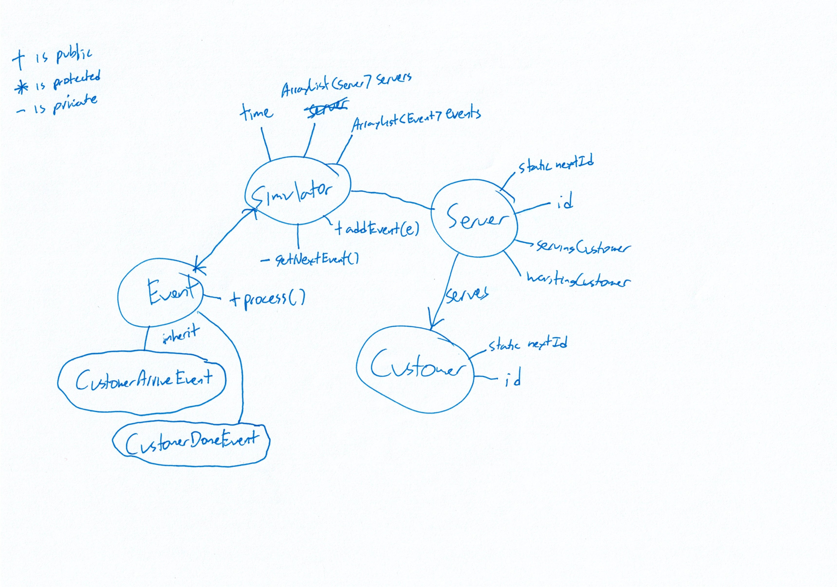
Think about events

Slide 7
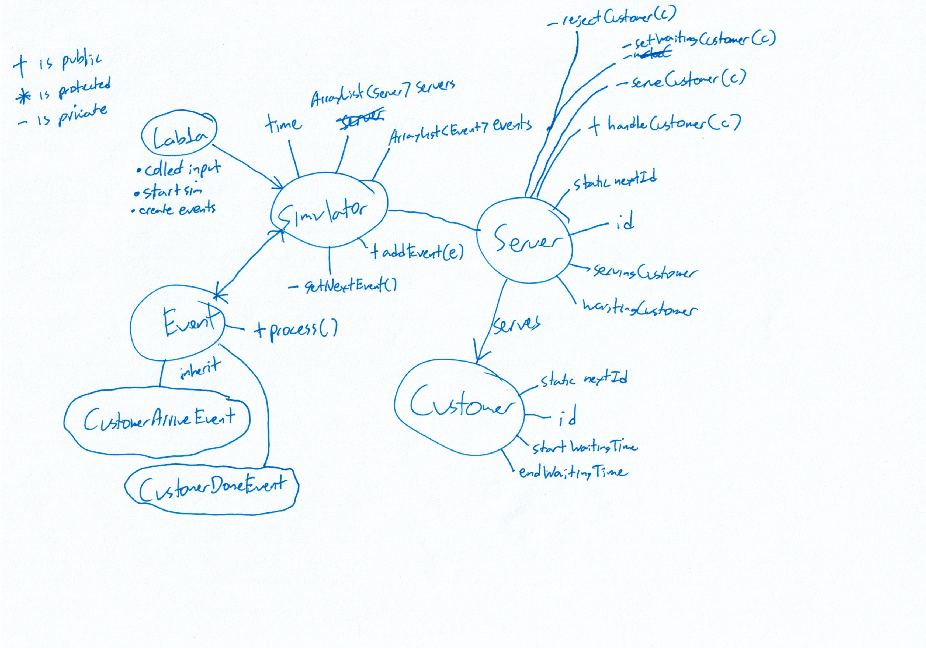
Customer Arrive Event

Slide 8
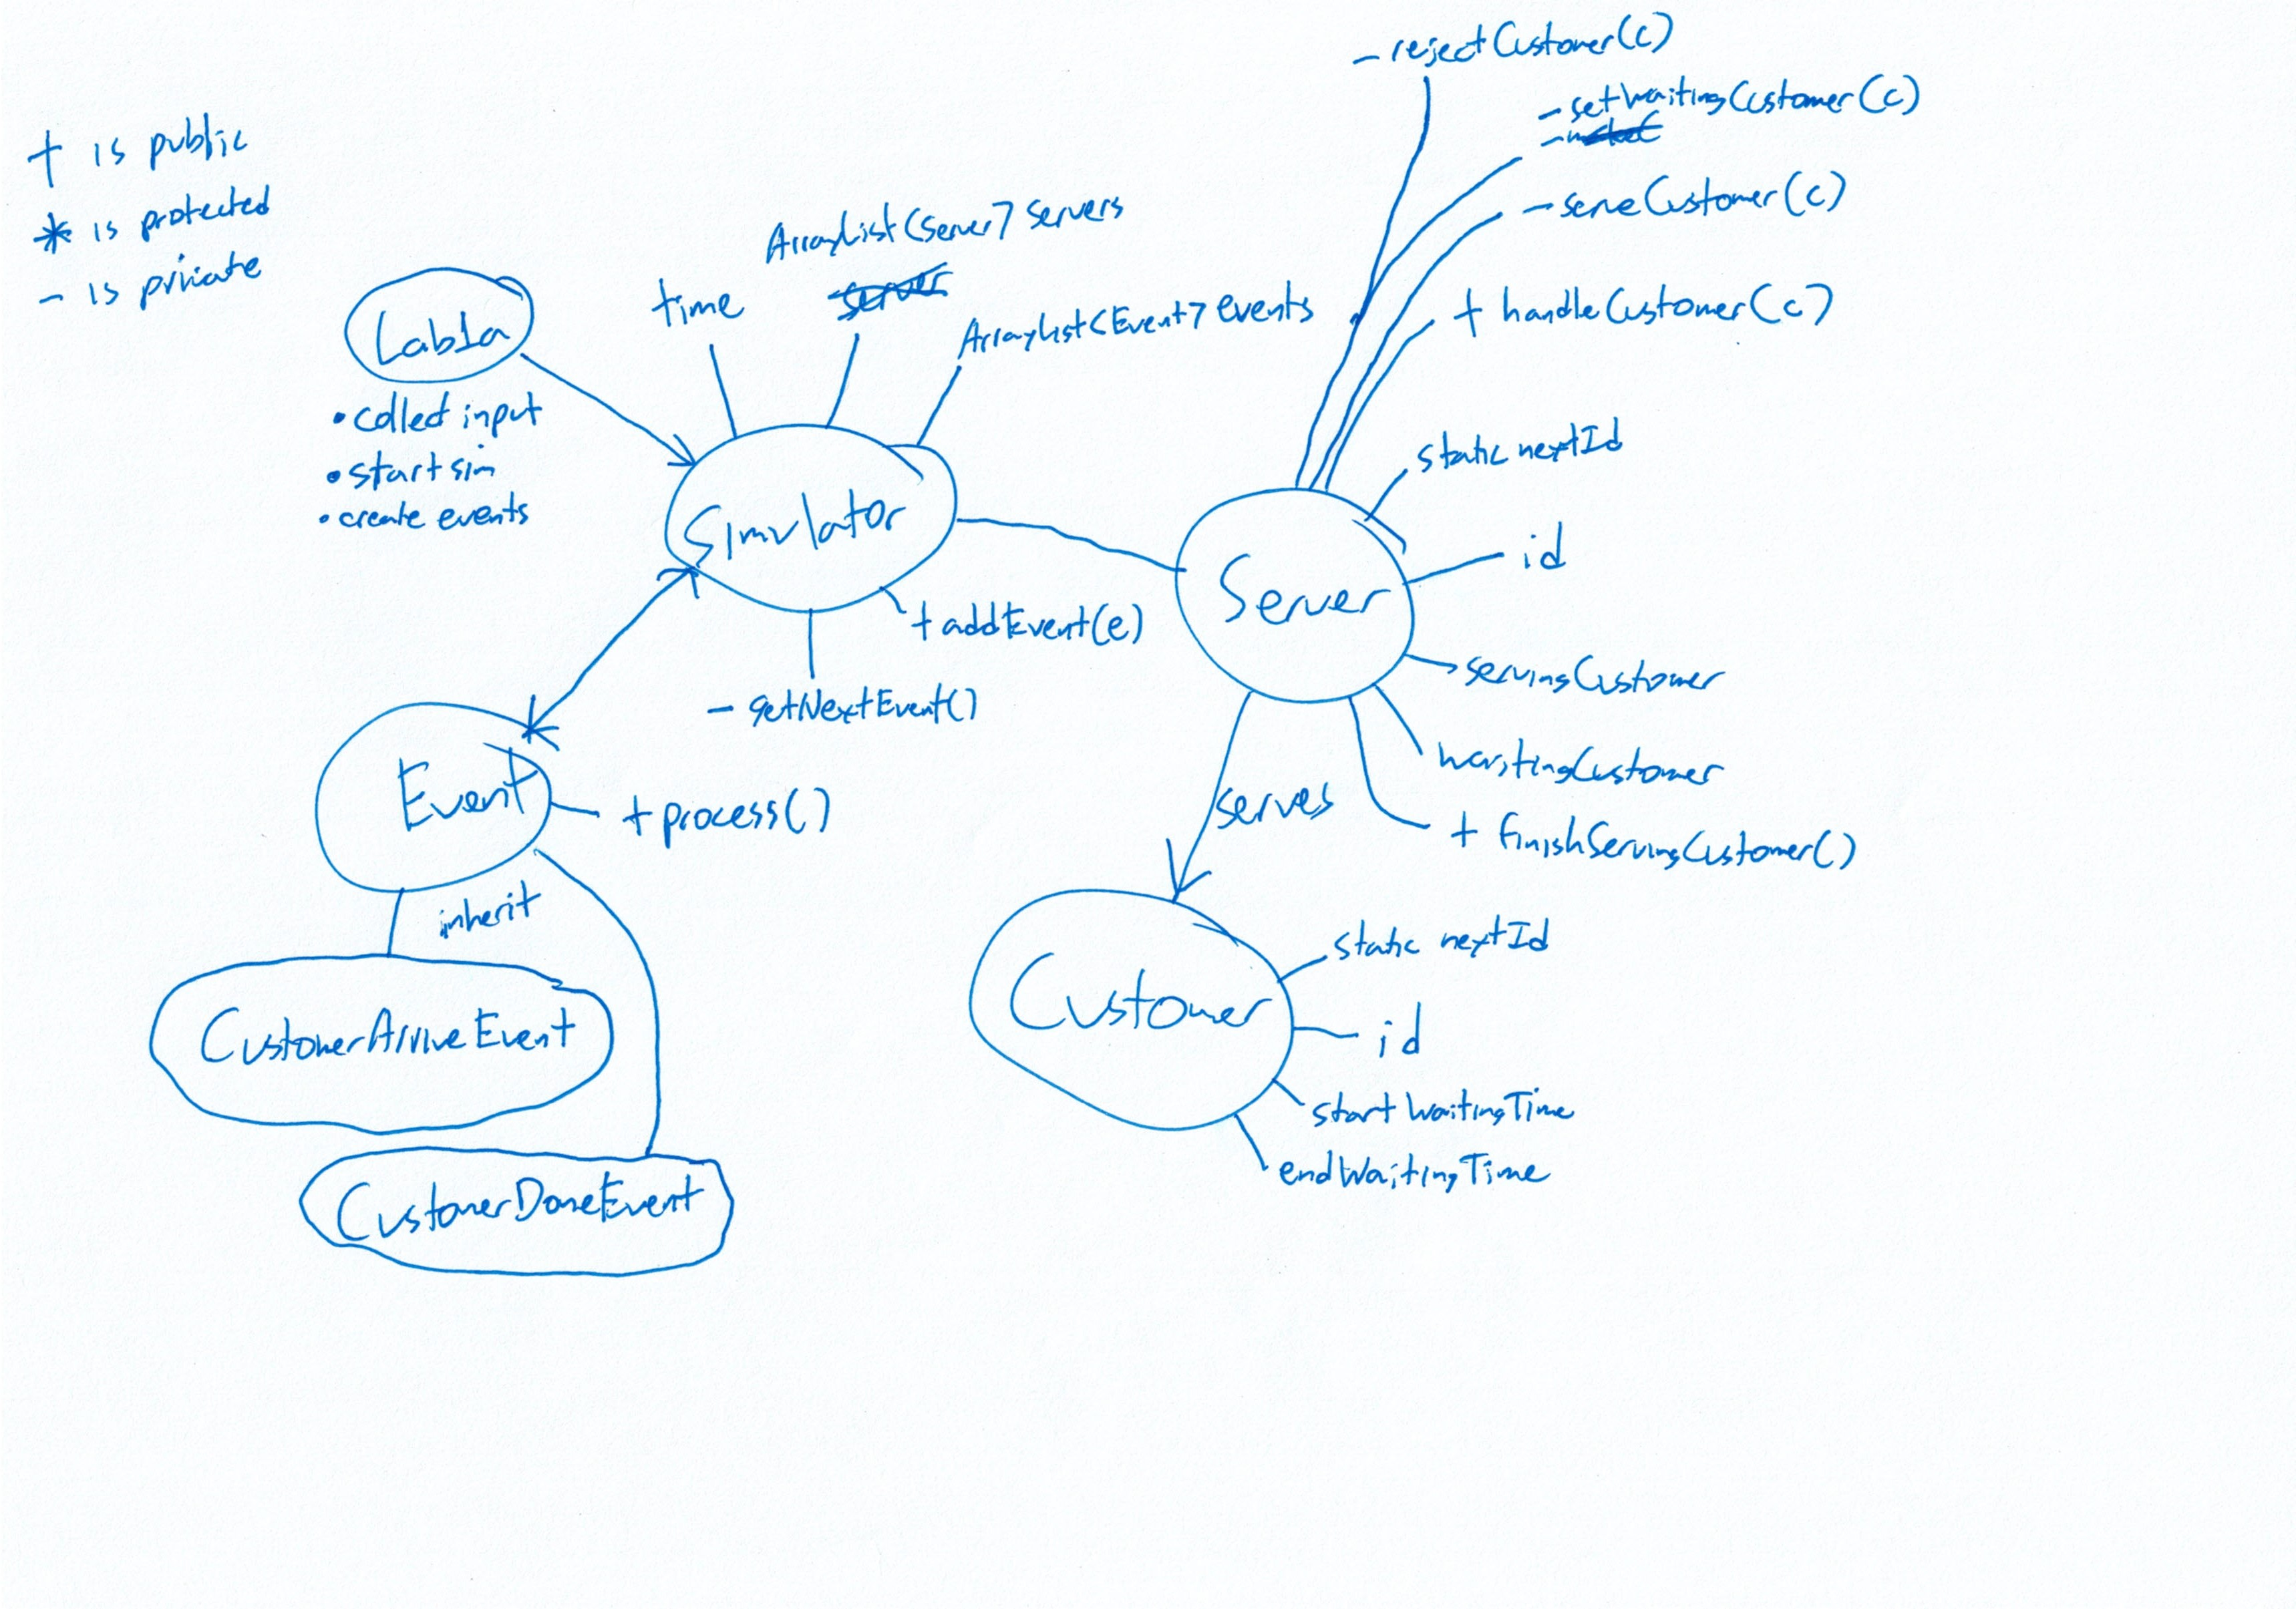
Customer Done Event

Slide 9
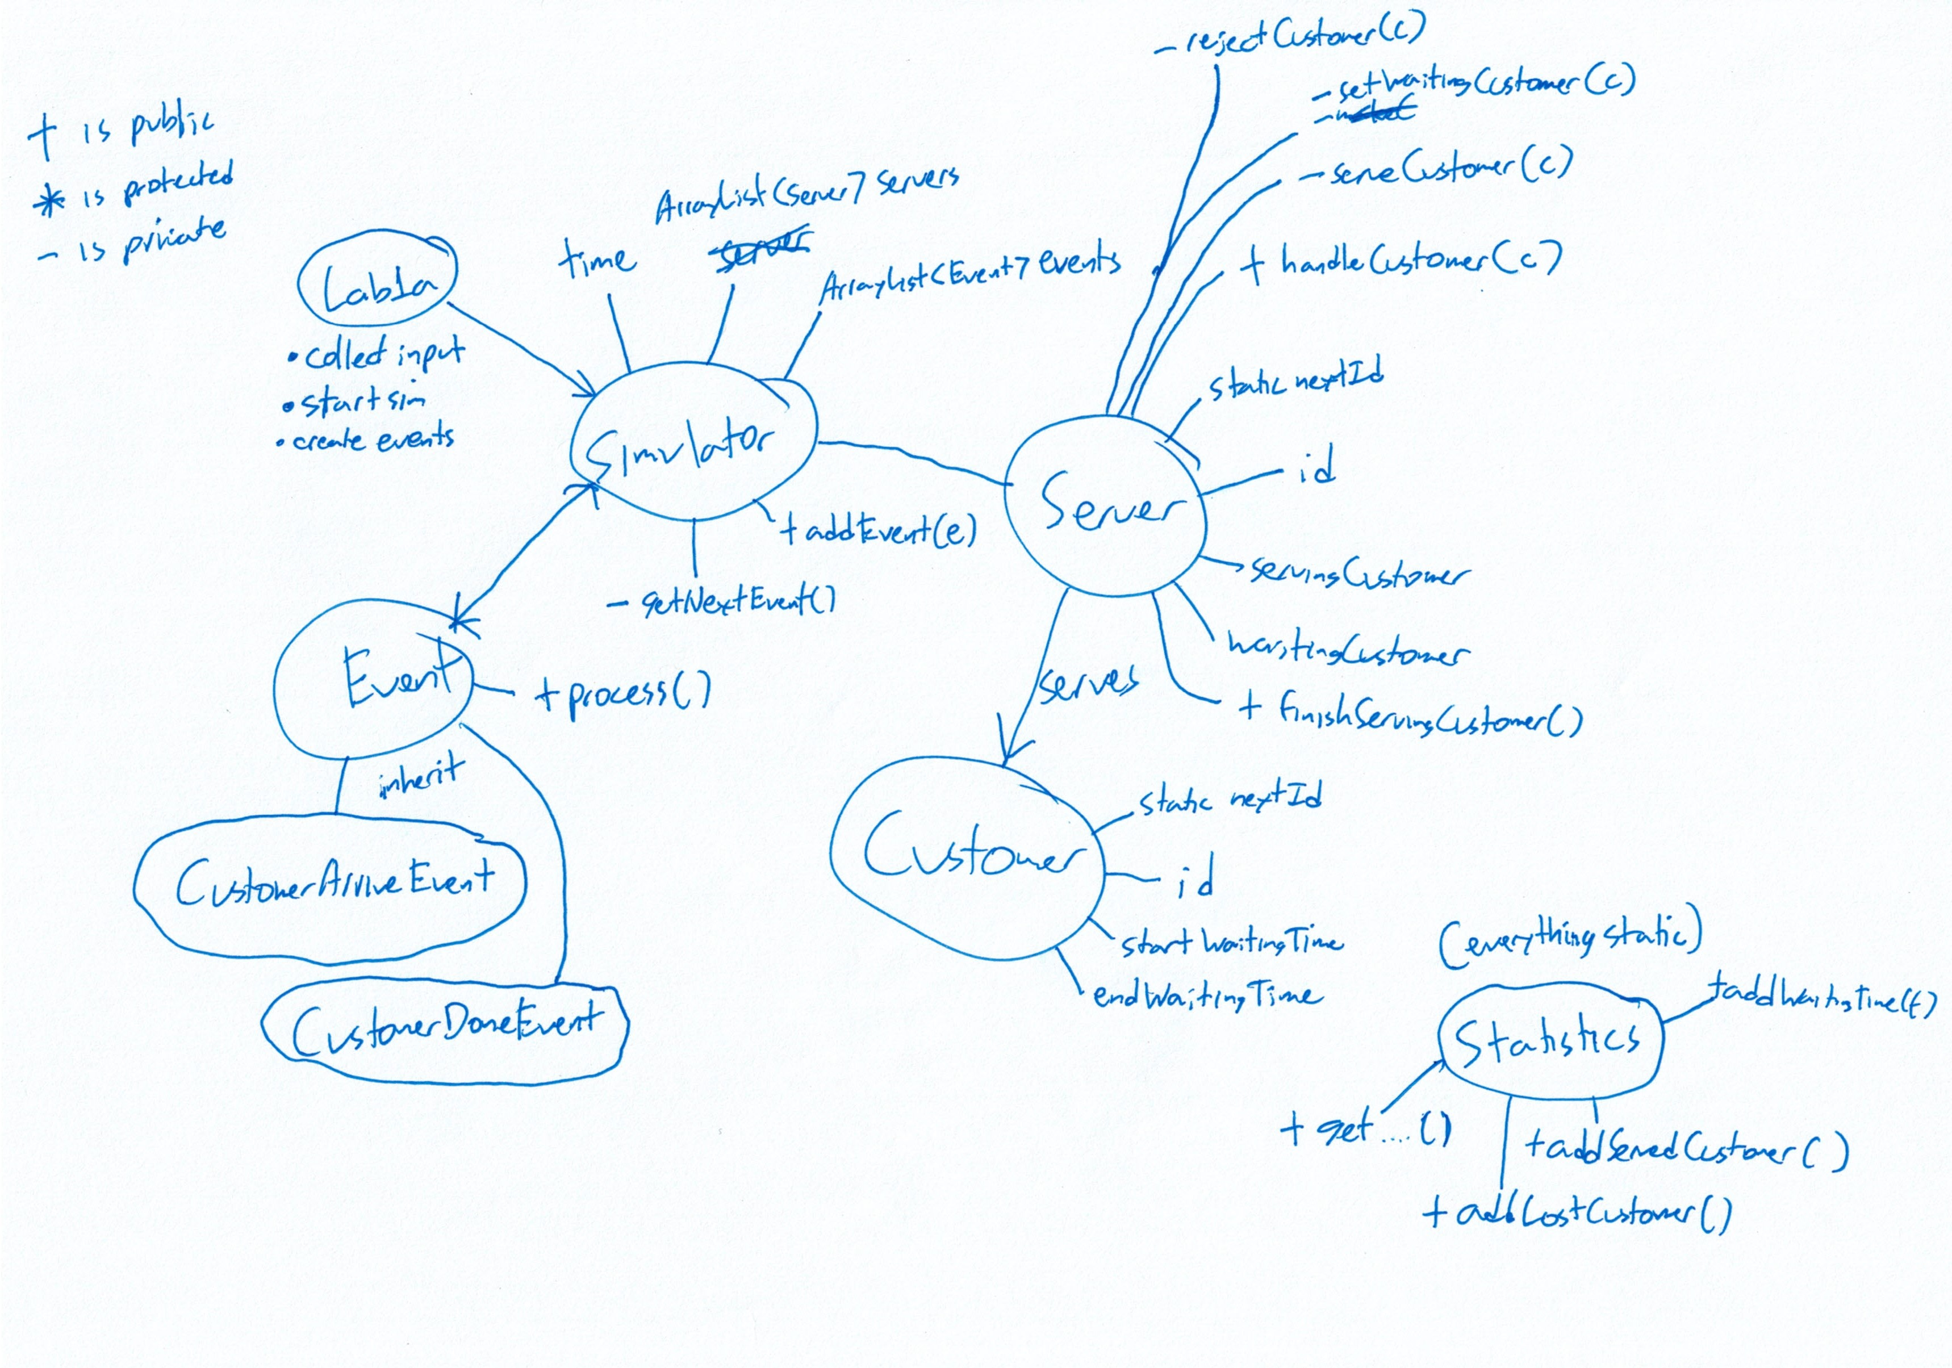
Statistics

Slide 10
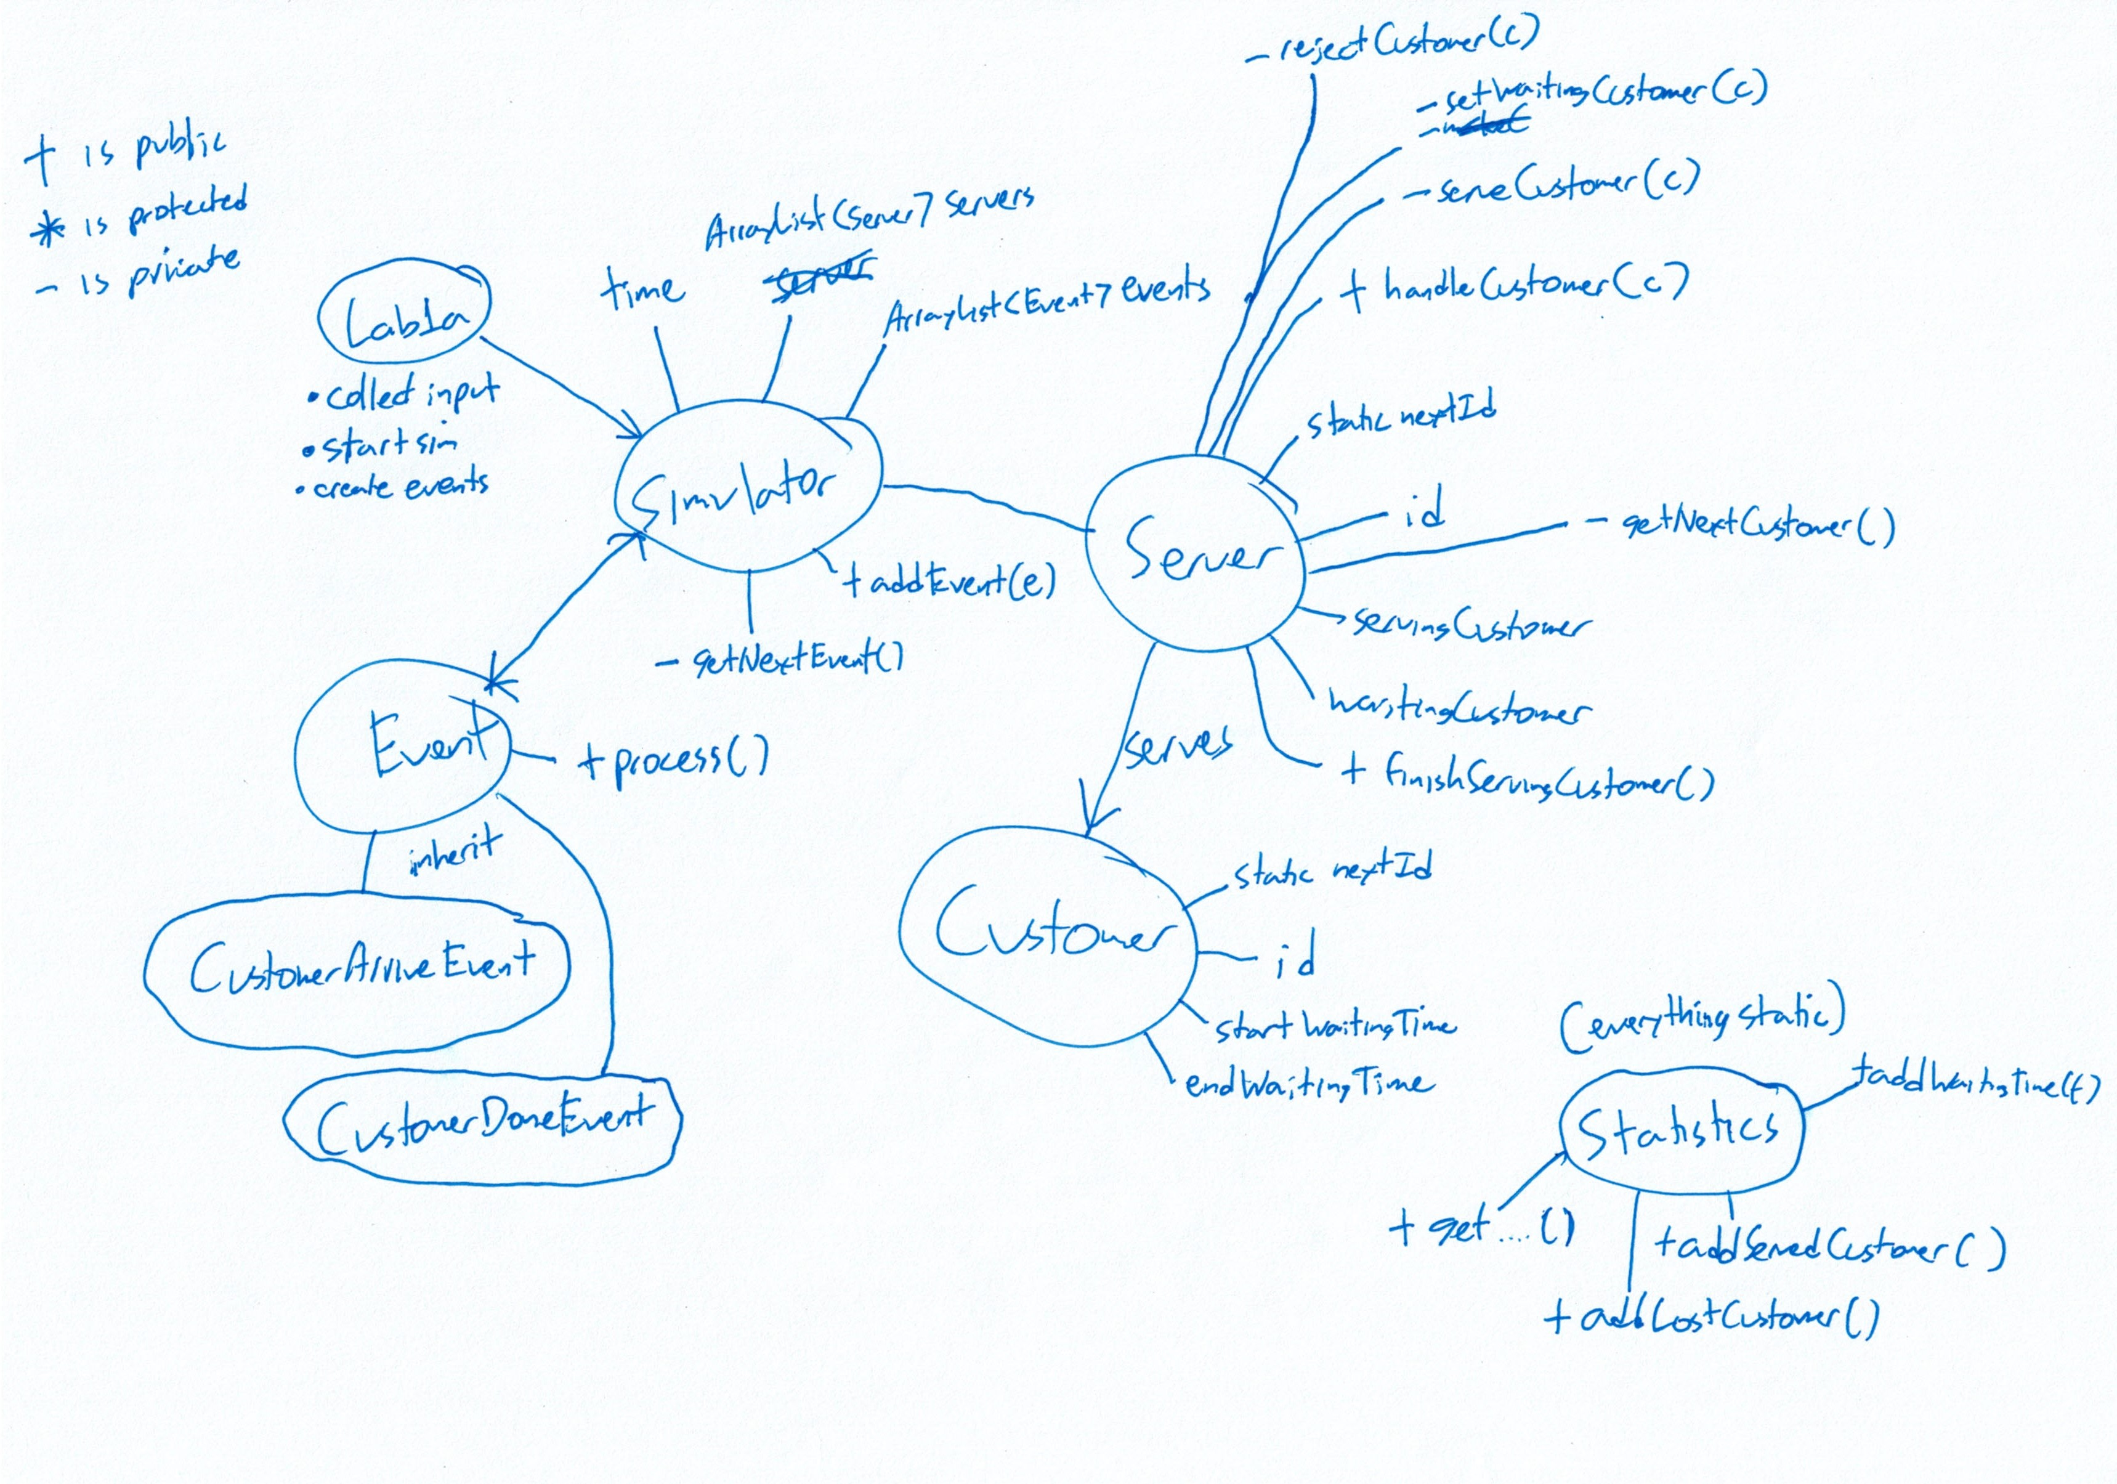
Extra – Multiple waiting customers?

Slide 12
Continuation to lab 1b
Just change CustomerArriveEvent to handle multiple servers if not already done
Done!

Slide 13
Extra – Comments & Javadocs
Not important for this lab (Ungraded)
Useful for future labs
Sublime Text – DocBlockr plugin
Type /** [tab] to auto-template

